Slide 1

webtechnologie 1
6. ORM en SQLAlchemy

Slide 2
1. ORM

Slide 3
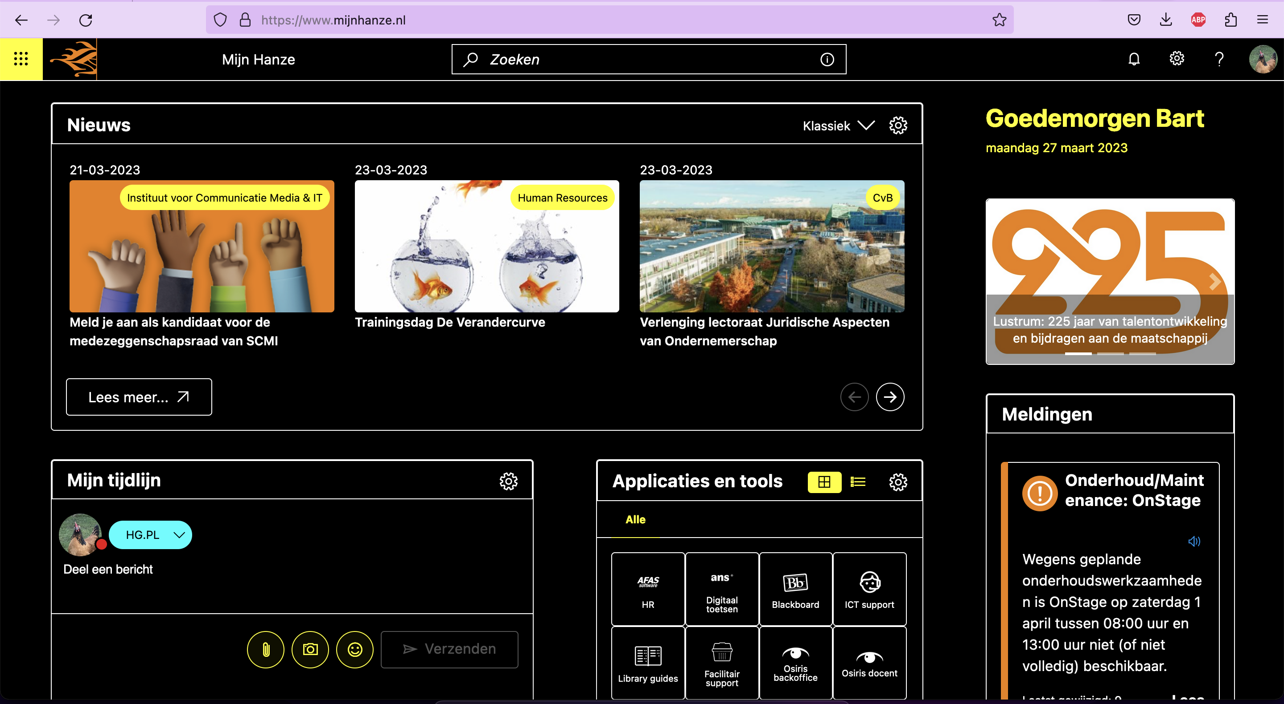
WHAT DO WE WANT?
DATA!
WHAT DO WE GET?
websites...

Slide 4

client
server
server process
router
scripts
templates
Object-domein
flask forms
Relationeel domein
database

Slide 5
een object ~ een regel uit de tabel
een klasse ~ een tabel
de properties van een klasse ~ de attributen van een tabel
waarden van de attributen ~ waarden in de betreffende regel

Slide 6
client
server
server process
router
scripts
templates
flask forms
Om de kloof tussen het relationele en het OO-domein te overbruggen.
Object Relational Mapping
ORM
database

Slide 7
2. SQLALCHEMY

Slide 8
class Mineral:
def __init__(self, name, price, desc):
self.name = name
self.price = price
self.description = desc
model class
1
mineral
ID int(11)
name VARCHAR(128)
price FLOAT
description TEXT

Slide 9
Specifieke database-engine
class Mineral:
tablename = 'mineral'
import sqlite3
def __init__(self, name, price, desc):
self.name = name
self.price = price
self.description = desc
self.save()
def save(self):
cursor = Mineral.conn().cursor()
sql = f'insert into {Mineral.tablename}
values ('{self.name},{self.price},{self.desc}')
cursor.execute(sql)
self.id = cursor.lastrowid
def conn():
return sqlite3.connect('mineral.sqlite3')
klasse doet te veel verschillende dingfen
klasse zelf verantwoordelijk voor z'n CRUD-operaties
context-switching (OO/relationeel)
Specifiek SQL-dialect
specifieke connectie-string
Gevoelig voor SQL-injecties

Slide 10
scripts
Je wilt je hier op kunnen richten
ORM
model
model
model
model
Dit moet allemaal vanzelf gaan

Slide 11
Connect with the database
Declare the mappings
Create the database
Close the connection
connection string
DDL
Connect with the database
Create a session
Do stuff with your mapped objects
Commit the session
Close the session
Close the connection
DML

Slide 12
from sqlalchemy import create_engine
from sqlalchemy.ext.declarative import declarative_base
from sqlalchemy import Column, Integer, String
base = declarative_base()
engine = create_engine('sqlite:///students.sqlite')
class Student(base):
__tablename__='students'
id = Column(Integer, primary_key=True)
name = Column(String)
base.metadata.create_all(engine)
connection string
Model class
CREATE TABLE IF NOT EXISTS "students" (
id INTEGER NOT NULL,
name VARCHAR,
PRIMARY KEY (id)
);

Slide 13
from sqlalchemy import create_engine
from sqlalchemy.ext.declarative import declarative_base
from sqlalchemy import Column, Integer, String, Date
base=declarative_base()
engine = create_engine('sqlite:///students.sqlite')
class Student(base):
__tablename__='students'
id = Column(Integer, primary_key=True)
name = Column(String, nullable=False)
dob = Column(Date, nullable=False)
base.metadata.create_all(engine)
Verschillende typen en attributen
CREATE TABLE IF NOT EXISTS "Students" (
id INTEGER NOT NULL,
name VARCHAR NOT NULL,
dob DATE NOT NULL,
PRIMARY KEY (id)
);

Slide 14
Object Name | Description
BigInteger | A type for bigger int integers.
Boolean | A bool datatype.
Date | A type for datetime.date() objects.
DateTime | A type for datetime.datetime() objects.
Enum | Generic Enum Type.
Float | Type representing floating point types, such as FLOAT or REAL.
Integer | A type for int integers.
Interval | A type for datetime.timedelta() objects.
LargeBinary | A type for large binary byte data.
MatchType | Refers to the return type of the MATCH operator.
Numeric | A type for fixed precision numbers, such as NUMERIC or DECIMAL.
PickleType | Holds Python objects, which are serialized using pickle.
SchemaType | Mark a type as possibly requiring schema-level DDL for usage.
SmallInteger | A type for smaller int integers.
String | The base for all string and character types.
Text | A variably sized string type.
Time | A type for datetime.time() objects.
Unicode | A variable length Unicode string type.
UnicodeText | An unbounded-length Unicode string type.
https://docs.sqlalchemy.org/en/14/core/type_basics.html

Slide 15
import datetime
from sqlalchemy.orm import sessionmaker
Session = sessionmaker(bind=engine)
sessionobj = Session()
henk = Student(name='Henk', dob=datetime.datetime(1970,11,27))
sessionobj.add(henk)
sessionobj.commit()

Slide 16
import datetime
from sqlalchemy.orm import sessionmaker
Session = sessionmaker(bind=engine)
sessionobj = Session()
henk = Student(name='Henk', dob=datetime.datetime(1970,11,27))
fenna = Student(name='Fenna', dob=datetime.datetime(1970,11,19))
bart = Student(name='Bart', dob=datetime.datetime(1970,11,27))
frank = Student(name='Frank', dob=datetime.datetime(1979,1,27))
yfke = Student(name='Yfke', dob=datetime.datetime(2000,8,4))
sessionobj.add_all([henk,fenna,bart,frank,yfke])
sessionobj.commit()

Slide 17
from sqlalchemy.orm import sessionmaker
Session = sessionmaker(bind=engine)
sessionobj = Session()
for student in sessionobj.query(Student).order_by(Student.name):
print(student.name, student.dob)
Bart 1970-11-27
Fenna 1970-11-19
Frank 1979-01-27
Henk 1970-11-27
Henk 1970-11-27
Yfke 2000-08-04

Slide 18
Let op: je filtert de objecten (klassen), niet de database-rijen
from sqlalchemy.orm import sessionmaker
Session = sessionmaker(bind=engine)
sessionobj = Session()
for student in sessionobj.query(Student).filter(Student.name.like('%Fen%')):
print(student.name, student.dob)
Fenna 1970-11-19

Slide 19
3. SQLALCHEMY RELATIONS
zie ook https://docs.sqlalchemy.org/en/20/orm/basic_relationships.html

Slide 20
E-mailadres
*
1
Student
Vak
*
*

Slide 21
class Vak(base):
__tablename__ = 'vakken'
id = Column(Integer, primary_key=True)
name = Column(String)
semester = Column(Integer)
studiepunten = Column(Integer)
class Student(base):
__tablename__ = 'students'
id = Column(Integer, primary_key=True)
name = Column(String)
class Emailadres(base):
__tablename__ = 'emailadressen'
id = Column(Integer, primary_key=True)
adres = Column(String, nullable=False)

Slide 22
E-mailadres
class Emailadres:
def __init__(self, adres, student):
self.adres = adres
self.student = student
*
1
Student
class Student:
def __init__(self, name):
self.name = name
henk = Student('Frank')
email1 = Emailadres('frank@frank.com',henk)
email2 = Emailadres('frank@gmail.com',henk)

Slide 23
from sqlalchemy import ForeignKey
from sqlalchemy.orm import relationship
# meer imports...
Je kunt ook gebruik maken van `backref` in plaats van `back_populates`. Dit is een iets andere aanpak (en ook deprecated).
class Student(base):
__tablename__ = 'students'
id = Column(Integer, primary_key=True)
name = Column(String)
emailadressen = relationship("Emailadres", back_populates="student")
class Emailadres(base):
__tablename__ = 'emailadressen'
id = Column(Integer, primary_key=True)
adres = Column(String, nullable=False)
student_id = Column(Integer, ForeignKey('students.id'))
student = relationship("Student", back_populates="emailadressen")
https://docs.sqlalchemy.org/en/20/orm/relationship_api.html#sqlalchemy.orm.relationship.params.back_populates

Slide 24
CREATE TABLE students (
id INTEGER NOT NULL,
name VARCHAR,
PRIMARY KEY (id)
);
CREATE TABLE emailadressen (
id INTEGER NOT NULL,
adres VARCHAR NOT NULL,
student_id INTEGER,
PRIMARY KEY (id),
FOREIGN KEY(student_id) REFERENCES students (id)
);
https://docs.sqlalchemy.org/en/20/orm/basic_relationships.html#one-to-many

Slide 25
Student
Vak
*
*
Student
student_vak
Vak
1
*
*
1

Slide 26
from sqlalchemy import Table
# meer imports
student_vak = Table('student_vak', base.metadata,
Column('student_id', ForeignKey('students.id'), primary_key=True),
Column('vak_id', ForeignKey('vakken.id'), primary_key=True)
)
class Student(base):
__tablename__='students'
id = Column(Integer, primary_key=True)
name = Column(String)
vakken = relationship('Vak', secondary=student_vak,
back_populates='studenten')
class Vak(base):
__tablename__='vakken'
id = Column(Integer, primary_key=True)
name = Column(String)
semester = Column(Integer)
studiepunten = Column(Integer)
studenten = relationship('student', secondary=student_vak,
back_populates='vakken')

Slide 27
CREATE TABLE students (
id INTEGER NOT NULL,
name VARCHAR NOT NULL,
dob DATE NOT NULL,
PRIMARY KEY (id)
);
CREATE TABLE vakken (
id INTEGER NOT NULL,
name VARCHAR,
semester INTEGER,
studiepunten INTEGER,
PRIMARY KEY (id)
);
CREATE TABLE student_vak (
student_id INTEGER NOT NULL,
vak_id INTEGER NOT NULL,
PRIMARY KEY (student_id, vak_id),
FOREIGN KEY(student_id) REFERENCES students (id),
FOREIGN KEY(vak_id) REFERENCES vakken (id)
);
https://docs.sqlalchemy.org/en/20/orm/basic_relationships.html#many-to-many

Slide 28
DEMO

